Slide 1

Syllabus/Unit: code:B2 Understanding our environment
Lesson number: 2
Lesson Title: Grouping Organisms
Learning Outcomes | How I did | Targets
Learning Outcome 1: Explain what is meant by a species Explain how species can differ as a results of variation Grade C
Learning Outcome 2: Analyse the potential problems when classify an organism Grade B
Learning Outcome 3: Compare how evolutionary and ecological relationships can lead to variation within a species Grade A/A*
Connector:
Everyday new organisms are discovered. How would you go about deciding which group it should be placed in?

Slide 2

Extended Learning
Extended Learning task:
Find out the classification system for the following organisms: Humans, chimpanzee, tiger, lion, black rat,
Due date: next lesson
Criteria for Grade C:
Criteria for Grade B:
Criteria for Grade A:
Notes:
This slide has been deliberately moved forwards as leaving homework for the end of the lesson can sometimes mean it is abandoned if the teacher runs out of time.
Ideas for homework activities:
Three main types of homework: practice, preparation, and extension.
Practice:
Practice assignments reinforce newly acquired skills. For example, students who have just learned a new method of solving a mathematical problem should be given new sample problems to complete on their own.
Preparation:
Preparation assignments help students get ready for activities that will occur in the classroom. Students may, for example, be required to do background research on a topic to be discussed later in class.
Extension:
Extension assignments are frequently long-term continuing projects that parallel classwork. Students must apply previous learning to complete these assignments, which can include science fair projects and presentations.
designing a poster, leaflet
carrying out an interview/survey
researching further information
making up a story about key points
reading over notes and highlighting key points
making up a quiz for peers on key points
model mapping
explaining key points to others
1. Workbook-based tasks
Most published course materials include a workbook or practice book, mainly including consolidation exercises, short reading texts and an answer key. Most workbooks claim to be suitable for both class and self-study use, but are better used at home in order to achieve a separation of what is done in class and at home. Mechanical practice is thus shifted out of class hours, while this kind of exercise is particularly suited to peer- or self-checking and correction.
2. Preparation tasks
Rarely do teachers ask learners to read through the next unit of a coursebook, though there are advantages in involving students in the lesson plan and having them know what is coming. More motivating, however, is asking students to find and bring materials such as photographs and pictures, magazine articles which are relevant to the next topic, particularly where personalisation or relevance to the local context requires adaptation of course materials.
3. Extensive tasks
Sometimes tasks need to be set as guidance, but learners also need to be encouraged to read, listen and watch for pleasure. What is important is that learners share their experiences in class. Extensive reading and listening may be accompanied by dictionary work and a thematic or personalised vocabulary notebook, whereby learners can collect language which they feel is useful.
4. Guided discovery tasks
Whereas classroom teaching often involves eliciting language patterns and rules from learners, there is also the option of asking learners to notice language and make deductions for themselves at home. This leads to the sharing of knowledge and even peer teaching in the classroom.
5. Real-world tasks
These involve seeing, hearing and putting language to use in realistic contexts. Reading magazines, watching TV, going to the cinema and listening to songs are obvious examples, offering the option of writing summaries and reviews as follow-up activities. Technology facilitates chat and friendship networks, while even in monolingual environments, walking down a shopping street noticing shop and brand names will reveal a lot of language. As with extensive tasks, it is important for learners to share their experiences, and perhaps to collect them in a formal or informal portfolio.
6. Project work
It is a good idea to have a class or individual projects running over a period of time. Projects may be based on topics from a coursebook, the locality, interests and hobbies or selected individually. Project work needs to be guided in terms of where to find resources and monitored regularly, the outcome being a substantial piece of work at the end of a course or term of which the learner can claim ownership.

Slide 3

BIG picture
Key Question: What causes variation within species
How is this lesson relevant to every day life? Identify and maintain global diversity
What skills will you be developing this lesson?
HSW- by planning and carrying out an investigation/ Interpreting data/ evaluating an experiment
Numeracy- by using formulae in calculations
Literacy- by writing explanations using correctly spelt keywords and good grammar.
Team work- during a practical investigation
Self management- by completing an individual assignment by …..
Participation- during a practical activity
Reflection- through self and peer assessment of each outcome
Where does this lesson fit in to the rest of the topic? Lesson 1
Quick Discussion:
What do you already know?
Notes:
Big Picture Ideas:
Pose a problem/key Question for pupils to solve by the end of the lesson using the new understanding they gain along the way
Select a wow factor video clip to stimulate pupil engagement
Add in a music clip connected to the lesson subject and ask pupils to suggest links.
Find a Youtube clip of a professional who works in a related field
provide pupils with an overview of where this lesson fits in to the rest of the topic/module.

Slide 4

Keywords:
Classification
Kingdom
Phylum
Class
Order
Family
Genus
Species
Species
Evolution
Binomial System
Variation
Hybrids
Protoctista
Prokaryotes
Animal
Plant
Fungi
Put your hand up if there is any key word from the list that you don’t know the meaning of.
Notes:
This slide enables pupils to consider key vocabulary and reflect on words they may not be familiar with. Rather than just having keywords displayed or having to copy them down, pupils are given an activity to use the keywords to demonstrate their understanding of them. Again this slide can be moved to any point in the lesson especially if the keywords are the subject matter of the lesson. Cane also be used to gage misconceptions.

Slide 5

New Information for Learning Outcome 1
14:53
Species is a group of similar organisms that are capable of inter breeding to produce fertile offspring
E.g members of the dog species can breed to produce pups, which can also breed on maturity
Notes:
Nadia Habraszewski
HQFT Scaffold
Featherstone High School
5
Ideas to be added in Slide Bank at end

Slide 6
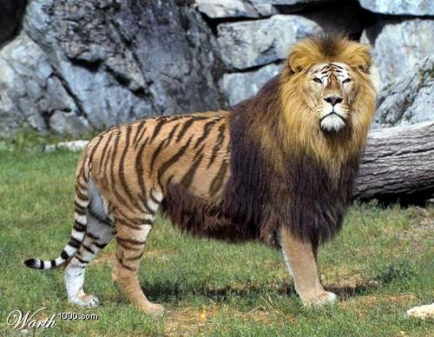
New Information for Learning Outcome 1
Liger - Lion and Tiger
The lion and tiger will not naturally breed but scientists have artificially mated the two. The liger is sterile which means it cannot reproduce
Notes:
Ideas to be added in Slide Bank at end

Slide 7
New Information for Learning Outcome 1
Biologists have a way of naming all organisms, called the binomial system
Each species is known by a 2 part name, the first name is genus which is a group of closely related species and the second name identifies a single species
Common Name | Genus | Species
Human | Homo | sapiens
Tiger | Panthera | tigris
Lion | Panthera | leo
Buttercup | Ranunculus | repens
14:59
Notes:
Nadia Habraszewski
HQFT Scaffold
Featherstone High School
7
Ideas to be added in Slide Bank at end

Slide 8
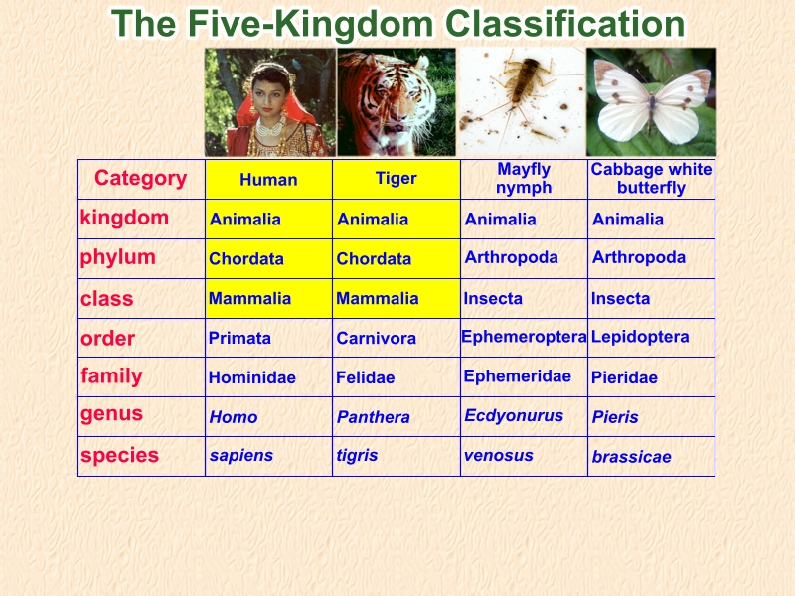

All mammals are classified in the same kingdom, phylum and class
At the next level – order – the mammals begin to diverge until
only those organisms with the greatest similarities and
the ability to interbreed share the species level

Slide 9
New Information for Learning Outcome 1
14:17
Within a species there is variation
Dogs have been bred for their looks or their ability to work
Although they show variation they have more in common than with other species because they share a common ancestor
Variation can be a results of the habitat they live in.
Notes:
Nadia Habraszewski
HQFT Scaffold
Featherstone High School
9
Ideas to be added in Slide Bank at end

Slide 10
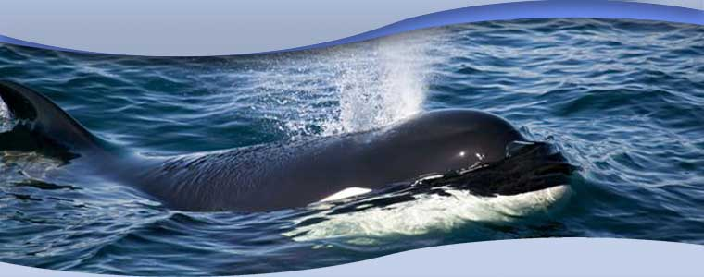
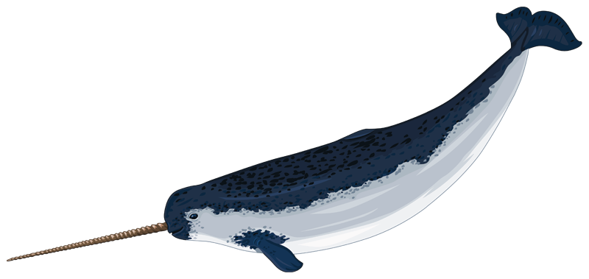
Classify the animals given below
What do I have to know about the organism to classify them?
Adaptations, behaviour, reproduction, external characteristics, internal physiology, genetics – DNA evidence for similarity in gene sequences
Notes:
Whale and Narwhal

Slide 11
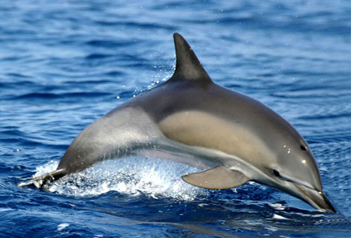

Dolphin and Shark
Dolphin classification Kingdom Animalia Phylum Chordata,
Subphylum Vertebrata,
Class Mammalia,
Shark classification Kingdom Animalia
Phylum Chordata
SubPhylum Vertebrata
Class Chondrichthyes (cartilaginous fish)
Sharks and Dolphin are not closely related but share several features as they live in the same habitat. There is an ecological link between the two but they are not classified together as they are unrelated in the evolutionary scale. One is a mammal and the other a fish

Slide 12

Learning activities for Lesson Outcome 1 (Grade C)
Task 1a:
Define what is meant by a species. Use examples
Task 1b
What is an advantage of having this binomial system of classification?
Task 1c
Explain using examples what could be reasons for variation within a species
Keywords for Task 1:
Interbreed
Characteristics
Fertile
common
variation
Notes:
Command words for tasks:
Blooms taxonomy (in increasing order of complexity)
Recall/Describe
Understand/Explain
Apply
Analyse
Evaluate
Create
Other useful command words:
Analyse Separate information into components and identify their characteristics.
Annotate To provide notes of explanation.
Apply Put into effect in a recognised way.
Assess Make an informed judgement.
Calculate Generate a numerical answer, with working shown.
Comment Present an informed opinion or infer points of interest relevant to the context of
the question.
Compare Identify similarities.
Complete Write the information required.
Consider Review and respond to information provided.
Contrast Identify differences.
Deduce Draw conclusions from information provided.
Define Specify meaning of the word or term.
Demonstrate Provide clear evidence.
Describe Provide a detailed account (using diagrams/data from figures or tables where
appropriate). The depth of the answer should be judged from the marks allocated
for the question.
Determine The quantity cannot be measured directly but can be obtained by calculation. A
value can be obtained by following a specific procedure or substituting values
into a formula.
Discuss Give a detailed account that addresses a range of ideas and arguments.
Distinguish Recognise and identify difference(s).
Draw Produce a diagram or to infer.
Estimate Assign an approximate value.
Evaluate Judge from available evidence.
Examine Investigate closely.
Explain Set out reasons or purposes using biological background. The depth of treatment
should be judged from the marks allocated for the question.
Identify Recognise or select relevant characteristics.
Illustrate Make clear by using examples or provide diagrams.
Interpret Translate information provided.
Justify Present a reasoned case.
Label To indicate (by using a straight line).
List Provide a number of points with no elaboration. If you are asked for two points
then give only two!
Measure Establish a value using a suitable measuring instrument.
Name To provide appropriate word(s) or term(s).
Outline Restrict the outline to essential detail only.
Plot Mark out points on a graph or illustrate by use of a suitable graph.
Predict Suggest possible outcome(s).
Recall Repeat knowledge from prior learning.
Recognise To identify.
Record Report or note.
Relate Make interconnections.
Sketch Produce a simple, freehand drawing. A single clear sharp line should be used.
In the context of a graph, the general shape of the curve would be sufficient.
State Produce a concise answer with no supporting argument.
Suggest Apply your biological knowledge and understanding to a situation which you may
not have covered in the specification.
Summarise Present main points in outline only.
Use Apply the information provided or apply prior learning.
How: Describe in what way or by what means……
What: Provide specific information……
Why: Explain the reason or purpose……
Accuracy: The accuracy of an observation, reading or measurement is the degree to which
it approaches a notional ‘true’ value or outcome. For example: closeness to a
line of best fit; accuracy of apparatus on percentage error.
Precision: The ability to be exact (degree of precision).
Reliability: The measure of confidence that can be placed in a set of observations or
measurements. For example: confidence limits of statistical tests or
concordance of repeats or standard deviation.
Validity: The implication that the outcome of an activity is not being distorted by
extraneous factors.
Independent enquiry tasks:
• identify questions to answer and problems to resolve
• plan and carry out research, appreciating the consequences of decisions
• explore issues, events or problems from different perspectives
• analyse and evaluate information, judging its relevance and value
• consider the influence of circumstances, beliefs and feelings on decisions and
events
• support conclusions, using reasoned arguments and evidence
Creative thinking activities:
generate ideas and explore possibilities
• ask questions to extend their thinking
• connect own and others’ ideas and experiences in inventive ways
• question own and others’ assumptions
• try out alternatives or new solutions and follow ideas through
• adapt ideas as circumstances change
Reflective Learning:
assess themselves and others, identifying opportunities and achievements
• set goals with success criteria for their development and work
• review progress, acting on the outcomes
• invite feedback and deal positively with praise, setbacks and criticism
• evaluate experiences and learning to inform future progress
• communicate their learning in relevant ways for different audiences
Team work:
• co-operate with others to work towards common goals
• reach agreements, managing discussions to achieve results
• adapt behaviour to suit different roles and situations
• show fairness and consideration to others
• take responsibility, showing confidence in themselves and their contribution
• provide constructive support and feedback to others
Self Management:
• seek out challenges or new responsibilities and show flexibility when priorities
change
• work towards goals, showing initiative, commitment and perseverance
• organise time and resources, prioritising actions
• anticipate, take and manage risks
• deal with competing pressures, including personal and work-related demands
• respond positively to change, seeking advice and support when needed
Effective participation:
• discuss issues of concern, seeking resolution where needed
• present a persuasive case for action
• propose practical ways forward, breaking these down into manageable steps
• identify improvements that would benefit others as well as themselves
• try to influence others, negotiating and balancing diverse views to reach
workable solutions
• act as an advocate for views and beliefs that may differ from their own
Example: Plan and undertake a research project
Working individually, students were required to plan and carry out a piece of
research. They decided on a methodology, carried out initial desk research using
the internet and developed a short questionnaire. They circulated the
questionnaire to appropriate people, and analysed the responses. They produced
a written report of the work, including their findings and recommendations and
presented their results to a peer group. The group discussed the work and gave
feedback on the report and presentation. Students were encouraged to reflect on
the experience and discuss with their tutor what went well, and what they might
do differently in future.
This activity presents the opportunity for the development of the following PLTs:
Independent enquirers, Creative thinkers, Reflective Learners, Self-managers.
Aspects of Team workers and Effective participators might also be developed
depending on the precise nature of the research project.

Slide 13


Demonstrate your Learning for Outcome 1
Create
Evaluate (A)
Dolphin and sharks are different species and are not closely related but they share common features. Explain how?
Evaluate
Analyse (B)
The are lot of varieties of horses explain how biologists know these are the same species?
Donkeys and horses look vary similar suggest why this is?
Analyse
Apply
Apply (C)
The are lot of varieties of horses explain how biologists know these are the same species?
Understand
Remember
Understand (D)
Define the key terms – species, variation, bionomial system
Notes:
1) Teacher selects at least three options from this slide (for three tier differentiation). Teacher then selects relevant prompt word for each task and deletes others. Should be a written task which can be self/peer/teacher assessed.
2) Visual displays of thinking scaffolds to be put up in the class room which provide guidance on how to complete each option.
3) Thinking Scaffold for each task to be made available for each pupil depending on which task they choose.
3) Support cards eg of keywords for extra help.

Slide 14

Learning Outcome 1: Review
Go back to your Learning Outcome grid and fill out the ‘How I did’ and the ‘Targets’ column.
Learning Outcome | How I did | Targets
Learning Outcome 1: Explain what is meant by a species Explain how species can differ as a results of variation Grade C | Met? Partly met? Not met? | How can I improve on Learning Outcome 1?
Notes:
Can be done as self or peer assessment activity
Can use the traffic light cards to express how well you did on the task

Slide 15

New Information for Learning Outcome 2
Visual:
Audio:
Kinaesthetic: Practical

Slide 16
New Information for Learning Outcome 2
Organisms can be difficult to classify as they are constantly changing due to evolution.
Examples where classification my be a problem
Bacteria – they do not interbreed they reproduce asexually.
Dolphins and whales – mammals, yet they look and live like fish. Their ancestors lived on land but evolved to live in the sea.
Hybrids – when two animals from different species breed together. Mule is from a male donkey and female horse. However it is sterile and is not a species
Notes:
Nadia Habraszewski
HQFT Scaffold
Featherstone High School
16

Slide 17
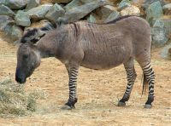
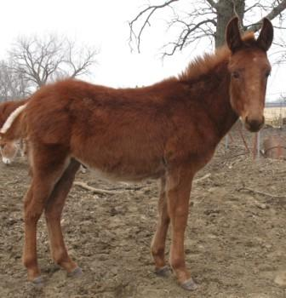
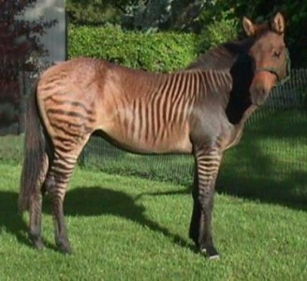
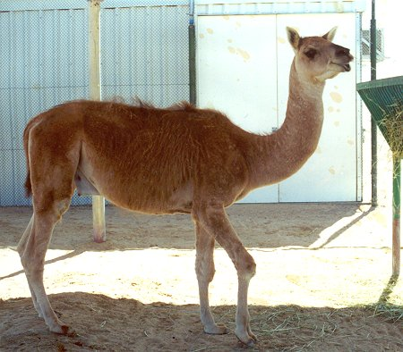
New Information for Learning Outcome 2
14:17
Notes:
Nadia Habraszewski
HQFT Scaffold
Featherstone High School
17
Zebra and Donkey
Camel and Lama
Horse and donkey – mule
Tiger and lion
Zebra and horse

Slide 18

Learning activities for Lesson outcome 2 (Grade B)
Task 2:
Using examples explain some of the problems when trying to classify organisms
Keywords for Task
Hybrid
Asexually
reproduce
evolution
fertile
offspring
characteristics
Notes:
Command words for tasks:
Blooms taxonomy (in increasing order of complexity)
Recall/Describe
Understand/Explain
Apply
Analyse
Evaluate
Create
Other useful command words:
Analyse Separate information into components and identify their characteristics.
Annotate To provide notes of explanation.
Apply Put into effect in a recognised way.
Assess Make an informed judgement.
Calculate Generate a numerical answer, with working shown.
Comment Present an informed opinion or infer points of interest relevant to the context of
the question.
Compare Identify similarities.
Complete Write the information required.
Consider Review and respond to information provided.
Contrast Identify differences.
Deduce Draw conclusions from information provided.
Define Specify meaning of the word or term.
Demonstrate Provide clear evidence.
Describe Provide a detailed account (using diagrams/data from figures or tables where
appropriate). The depth of the answer should be judged from the marks allocated
for the question.
Determine The quantity cannot be measured directly but can be obtained by calculation. A
value can be obtained by following a specific procedure or substituting values
into a formula.
Discuss Give a detailed account that addresses a range of ideas and arguments.
Distinguish Recognise and identify difference(s).
Draw Produce a diagram or to infer.
Estimate Assign an approximate value.
Evaluate Judge from available evidence.
Examine Investigate closely.
Explain Set out reasons or purposes using biological background. The depth of treatment
should be judged from the marks allocated for the question.
Identify Recognise or select relevant characteristics.
Illustrate Make clear by using examples or provide diagrams.
Interpret Translate information provided.
Justify Present a reasoned case.
Label To indicate (by using a straight line).
List Provide a number of points with no elaboration. If you are asked for two points
then give only two!
Measure Establish a value using a suitable measuring instrument.
Name To provide appropriate word(s) or term(s).
Outline Restrict the outline to essential detail only.
Plot Mark out points on a graph or illustrate by use of a suitable graph.
Predict Suggest possible outcome(s).
Recall Repeat knowledge from prior learning.
Recognise To identify.
Record Report or note.
Relate Make interconnections.
Sketch Produce a simple, freehand drawing. A single clear sharp line should be used.
In the context of a graph, the general shape of the curve would be sufficient.
State Produce a concise answer with no supporting argument.
Suggest Apply your biological knowledge and understanding to a situation which you may
not have covered in the specification.
Summarise Present main points in outline only.
Use Apply the information provided or apply prior learning.
How: Describe in what way or by what means……
What: Provide specific information……
Why: Explain the reason or purpose……
Accuracy: The accuracy of an observation, reading or measurement is the degree to which
it approaches a notional ‘true’ value or outcome. For example: closeness to a
line of best fit; accuracy of apparatus on percentage error.
Precision: The ability to be exact (degree of precision).
Reliability: The measure of confidence that can be placed in a set of observations or
measurements. For example: confidence limits of statistical tests or
concordance of repeats or standard deviation.
Validity: The implication that the outcome of an activity is not being distorted by
extraneous factors.
Independent enquiry tasks:
• identify questions to answer and problems to resolve
• plan and carry out research, appreciating the consequences of decisions
• explore issues, events or problems from different perspectives
• analyse and evaluate information, judging its relevance and value
• consider the influence of circumstances, beliefs and feelings on decisions and
events
• support conclusions, using reasoned arguments and evidence
Creative thinking activities:
generate ideas and explore possibilities
• ask questions to extend their thinking
• connect own and others’ ideas and experiences in inventive ways
• question own and others’ assumptions
• try out alternatives or new solutions and follow ideas through
• adapt ideas as circumstances change
Reflective Learning:
assess themselves and others, identifying opportunities and achievements
• set goals with success criteria for their development and work
• review progress, acting on the outcomes
• invite feedback and deal positively with praise, setbacks and criticism
• evaluate experiences and learning to inform future progress
• communicate their learning in relevant ways for different audiences
Team work:
• co-operate with others to work towards common goals
• reach agreements, managing discussions to achieve results
• adapt behaviour to suit different roles and situations
• show fairness and consideration to others
• take responsibility, showing confidence in themselves and their contribution
• provide constructive support and feedback to others
Self Management:
• seek out challenges or new responsibilities and show flexibility when priorities
change
• work towards goals, showing initiative, commitment and perseverance
• organise time and resources, prioritising actions
• anticipate, take and manage risks
• deal with competing pressures, including personal and work-related demands
• respond positively to change, seeking advice and support when needed
Effective participation:
• discuss issues of concern, seeking resolution where needed
• present a persuasive case for action
• propose practical ways forward, breaking these down into manageable steps
• identify improvements that would benefit others as well as themselves
• try to influence others, negotiating and balancing diverse views to reach
workable solutions
• act as an advocate for views and beliefs that may differ from their own
Example: Plan and undertake a research project
Working individually, students were required to plan and carry out a piece of
research. They decided on a methodology, carried out initial desk research using
the internet and developed a short questionnaire. They circulated the
questionnaire to appropriate people, and analysed the responses. They produced
a written report of the work, including their findings and recommendations and
presented their results to a peer group. The group discussed the work and gave
feedback on the report and presentation. Students were encouraged to reflect on
the experience and discuss with their tutor what went well, and what they might
do differently in future.
This activity presents the opportunity for the development of the following PLTs:
Independent enquirers, Creative thinkers, Reflective Learners, Self-managers.
Aspects of Team workers and Effective participators might also be developed
depending on the precise nature of the research project.

Slide 19
Demonstrate your Learning for Outcome 2
Keywords:
Create
Evaluate (A)
Explain how biologists know that donkey and horses are different species?
Evaluate
Analyse
Analyse (B)
Suggest which part of the bacteria scientists use to classify them into different species?
Apply
Apply (C)
Would you expect dolphins to have gills or lungs? Give reasons for your answer
Understand
Remember
Notes:
1) Teacher selects at least three options from this slide (for three tier differentiation). Teacher then selects relevant prompt word for each task and deletes others. Should be a written task which can be self/peer/teacher assessed.
2) Visual displays of thinking scaffolds to be put up in the class room which provide guidance on how to complete each option.
3) Thinking Scaffold for each task to be made available for each pupil depending on which task they choose.
3) Support cards eg of keywords for extra help.

Slide 20
Learning Outcome 2: Review
Go back to your Learning Outcome grid and fill out the ‘How I did’ and the ‘Targets’ column.
Learning Outcome | How I did | Targets
Learning Outcome 2: Analyse the potential problems when classify an organism Grade B | Met? Partly met? Not met? | How can I improve on Learning Outcome 2?
Notes:
Can be done as self or peer assessment activity

Slide 21
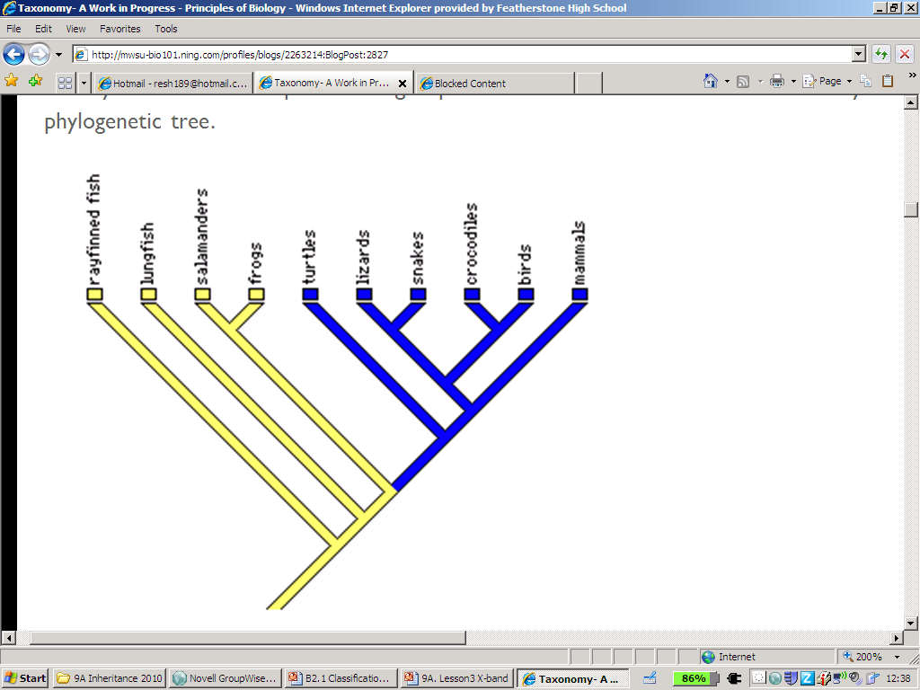
New Information for Learning Outcome 3
Classification can show both evolutionary and ecological relationships.
Evolutionary trees show close relationships between animals.
More similar characteristics the more closely related they share a common ancestor

Slide 22
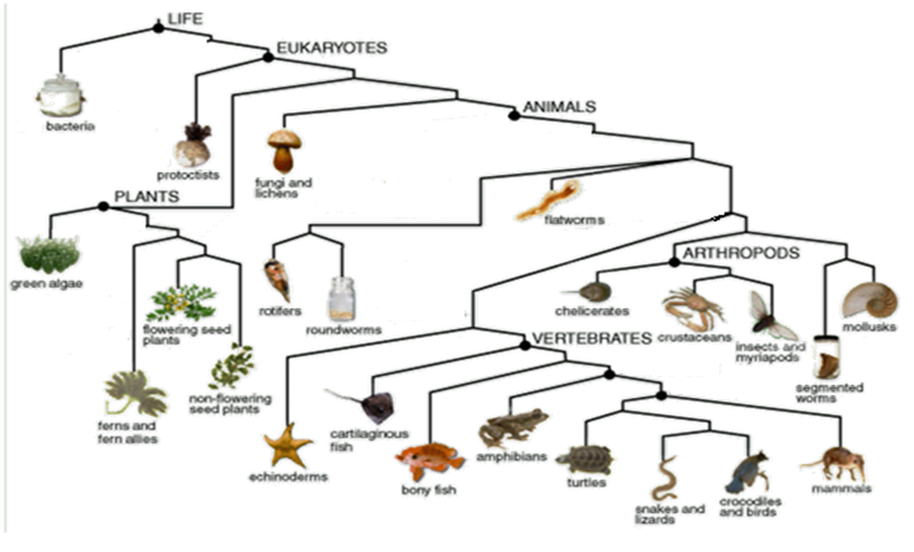

Slide 23
Learning activities for Lesson outcome 3 (Grade A)
Taxon | Animal X | Animal Y
Kingdom | Animalia | Animalia
Phylum | Athropod | Athropod
 | Insecta | Insecta
Order | Coleoptera | Coleoptera
Family | Coccinellidae | Coccinellidae
 | Adalia | Coccinella
Species | bipunctata | septempunctata
Common Name | 2 spot ladybird | 7 spot ladybird
Write down the missing taxons
Write down the binomial name for both ladybirds
The two ladybirds had a recent common ancestor. What evidence is there in the table to support this?
14:17
Notes:
Nadia Habraszewski
HQFT Scaffold
Featherstone High School
23
Command words for tasks:
Blooms taxonomy (in increasing order of complexity)
Recall/Describe
Understand/Explain
Apply
Analyse
Evaluate
Create
Other useful command words:
Analyse Separate information into components and identify their characteristics.
Annotate To provide notes of explanation.
Apply Put into effect in a recognised way.
Assess Make an informed judgement.
Calculate Generate a numerical answer, with working shown.
Comment Present an informed opinion or infer points of interest relevant to the context of
the question.
Compare Identify similarities.
Complete Write the information required.
Consider Review and respond to information provided.
Contrast Identify differences.
Deduce Draw conclusions from information provided.
Define Specify meaning of the word or term.
Demonstrate Provide clear evidence.
Describe Provide a detailed account (using diagrams/data from figures or tables where
appropriate). The depth of the answer should be judged from the marks allocated
for the question.
Determine The quantity cannot be measured directly but can be obtained by calculation. A
value can be obtained by following a specific procedure or substituting values
into a formula.
Discuss Give a detailed account that addresses a range of ideas and arguments.
Distinguish Recognise and identify difference(s).
Draw Produce a diagram or to infer.
Estimate Assign an approximate value.
Evaluate Judge from available evidence.
Examine Investigate closely.
Explain Set out reasons or purposes using biological background. The depth of treatment
should be judged from the marks allocated for the question.
Identify Recognise or select relevant characteristics.
Illustrate Make clear by using examples or provide diagrams.
Interpret Translate information provided.
Justify Present a reasoned case.
Label To indicate (by using a straight line).
List Provide a number of points with no elaboration. If you are asked for two points
then give only two!
Measure Establish a value using a suitable measuring instrument.
Name To provide appropriate word(s) or term(s).
Outline Restrict the outline to essential detail only.
Plot Mark out points on a graph or illustrate by use of a suitable graph.
Predict Suggest possible outcome(s).
Recall Repeat knowledge from prior learning.
Recognise To identify.
Record Report or note.
Relate Make interconnections.
Sketch Produce a simple, freehand drawing. A single clear sharp line should be used.
In the context of a graph, the general shape of the curve would be sufficient.
State Produce a concise answer with no supporting argument.
Suggest Apply your biological knowledge and understanding to a situation which you may
not have covered in the specification.
Summarise Present main points in outline only.
Use Apply the information provided or apply prior learning.
How: Describe in what way or by what means……
What: Provide specific information……
Why: Explain the reason or purpose……
Accuracy: The accuracy of an observation, reading or measurement is the degree to which
it approaches a notional ‘true’ value or outcome. For example: closeness to a
line of best fit; accuracy of apparatus on percentage error.
Precision: The ability to be exact (degree of precision).
Reliability: The measure of confidence that can be placed in a set of observations or
measurements. For example: confidence limits of statistical tests or
concordance of repeats or standard deviation.
Validity: The implication that the outcome of an activity is not being distorted by
extraneous factors.
Independent enquiry tasks:
• identify questions to answer and problems to resolve
• plan and carry out research, appreciating the consequences of decisions
• explore issues, events or problems from different perspectives
• analyse and evaluate information, judging its relevance and value
• consider the influence of circumstances, beliefs and feelings on decisions and
events
• support conclusions, using reasoned arguments and evidence
Creative thinking activities:
generate ideas and explore possibilities
• ask questions to extend their thinking
• connect own and others’ ideas and experiences in inventive ways
• question own and others’ assumptions
• try out alternatives or new solutions and follow ideas through
• adapt ideas as circumstances change
Reflective Learning:
assess themselves and others, identifying opportunities and achievements
• set goals with success criteria for their development and work
• review progress, acting on the outcomes
• invite feedback and deal positively with praise, setbacks and criticism
• evaluate experiences and learning to inform future progress
• communicate their learning in relevant ways for different audiences
Team work:
• co-operate with others to work towards common goals
• reach agreements, managing discussions to achieve results
• adapt behaviour to suit different roles and situations
• show fairness and consideration to others
• take responsibility, showing confidence in themselves and their contribution
• provide constructive support and feedback to others
Self Management:
• seek out challenges or new responsibilities and show flexibility when priorities
change
• work towards goals, showing initiative, commitment and perseverance
• organise time and resources, prioritising actions
• anticipate, take and manage risks
• deal with competing pressures, including personal and work-related demands
• respond positively to change, seeking advice and support when needed
Effective participation:
• discuss issues of concern, seeking resolution where needed
• present a persuasive case for action
• propose practical ways forward, breaking these down into manageable steps
• identify improvements that would benefit others as well as themselves
• try to influence others, negotiating and balancing diverse views to reach
workable solutions
• act as an advocate for views and beliefs that may differ from their own
Example: Plan and undertake a research project
Working individually, students were required to plan and carry out a piece of
research. They decided on a methodology, carried out initial desk research using
the internet and developed a short questionnaire. They circulated the
questionnaire to appropriate people, and analysed the responses. They produced
a written report of the work, including their findings and recommendations and
presented their results to a peer group. The group discussed the work and gave
feedback on the report and presentation. Students were encouraged to reflect on
the experience and discuss with their tutor what went well, and what they might
do differently in future.
This activity presents the opportunity for the development of the following PLTs:
Independent enquirers, Creative thinkers, Reflective Learners, Self-managers.
Aspects of Team workers and Effective participators might also be developed
depending on the precise nature of the research project.

Slide 24
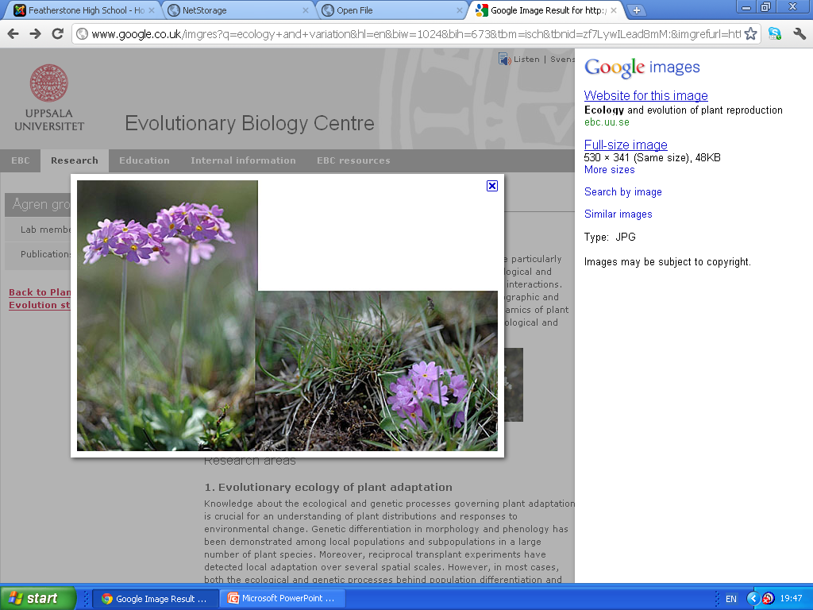
Variation in floral characters influences pollinator visitation, pollen transfer, and plant reproductive success, and of the genetic basis of variation in floral morphology.

Slide 25
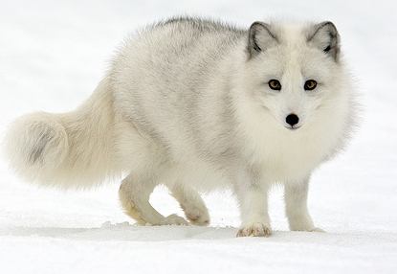
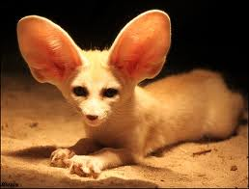
Demonstrate your Learning for Outcome 3
Keywords:
(A)
Create
Apply (C)
(A*)
Evaluate
Analyse
Analyse (B)
The Artic fox and the Fennec fox are found in two different habitats but belong to the same family. Compare the similarities and differences to explain the differences
Apply
Understand
Remember
Notes:
1) Teacher selects at least three options from this slide (for three tier differentiation). Teacher then selects relevant prompt word for each task and deletes others. Should be a written task which can be self/peer/teacher assessed.
2) Visual displays of thinking scaffolds to be put up in the class room which provide guidance on how to complete each option.
3) Thinking Scaffold for each task to be made available for each pupil depending on which task they choose.
3) Support cards eg of keywords for extra help.

Slide 26
Learning Outcome 3: Review
Go back to your Learning Outcome grid and fill out the ‘How I did’ and the ‘Targets’ column.
Learning Outcomes | How I did | Targets
Learning Outcome 3: Compare how evolutionary and ecological relationships can lead to variation within a species Grade A/A* | Met? Partly met? Not met? | How can I improve on Learning Outcome 3?
Notes:
Can be done as self or peer assessment activity

Slide 27
Review for Remembering
Stand up if you have met all three lesson outcomes?
If not what do you need to do next in order to meet the outcome? Record this in your diary as part of your homework.
Is there any part of the lesson you think you need to go over again next lesson?
Tell the person next to you three things you have learnt this lesson.
How will you remember this for your exam?
Notes:
The end of lesson review allows the teacher to round off the lesson, recap key points and celebrate pupil success. Ideas for interactive review activities are given in the notes section. However if the teacher runs out of time there is no great loss as the pupils have already reviewed all the learning outcomes earlier on. Again by having the mini reviews after each outcome it enables the teacher to be more flexible and adapt the pace of the lesson to the learning needs of the class.
Ideas for interactive Review activities (can also be for Connectors)
Pass the parcel
Pass around a box filled with statements about the topic you will be studying in the lesson. Play music, when the music stops, the child with the box must pick out a statement, read it and decide whether it is true or false. The statement can then be placed in a corresponding hoop – true/false or agree/disagree etc.
Could also be used to review what they learnt in the previous session by filling the box with questions which the children should answer when they pick them out.
Move to the answer
Similar to pass the parcel. Can pick a statement from a box/hat etc and class must move according to what they think of the statement – dedicate an area of the classroom to agree and one to disagree. Could work for maths questions – odd/even, multiple of 3, multiple of 10 etc.
Beat the teacher
Everyone (teacher included) has a mini-whiteboard and pen. Teacher gives a calculation (I tend to use it for grid method practice) and pupils and teacher start doing it. I either give them the time it takes me plus 1 min, or set a timer on the IWB to do it. They love it! Means you get instant feedback as to how they are doing and it gives them competition to be the first with correct answer.
Bingo
Use with numbers, words, pictures etc. Can choose own numbers, but with words and pictures it’s usually best to have something created in advance. Not just to be used for maths – consider other areas of the curriculum!
Definition bingo where you give the children a selection of words to choose 4 from, then you read the definitions. First one to cross off their 4 words wins. It works well with maths, science, geography and French.
Box game
Child comes up to the front and steps into the imaginary box (but there's no reason why it couldn't be real!), they then can't leave until they get a question correct (maths).
Easy/Medium/Hard/Mega-hard
Hard/medium/easy/mega hard - I start by picking someone, and give them a medium question, they then get to pick next person and level of difficulty, of course they always pick hard or mega hard for them to do so it's a good way to test them on other stuff and you're not picked on for choosing the 'victims'.
Blockbusters
http://www.bigbrownenvelope.co.uk/ - version for promethean and smartboard on here.
http://www.teachers-direct.co.uk/resources/quiz-busters/subjects/ks2.aspx - lots of versions already made on here – fantastic free resource.
Who wants to be a millionaire?
www.primaryresources.co.uk (sorry, can’t provide an actual link as they don’t work for some reason!) hosts a free powerpoint version of this.
Find me a partner
Half of the class are given questions and half are given answers. Children must silently go around the room trying to find out who their partner is. Could also be done with them talking and the questions and answers being stuck on their backs to make it a bit more challenging. Alternatively, instead of questions finding answers, questions could find other questions which provide the same answer or answers could find other answers from the same times tables and then order themselves. Many different possibilities for this one!
Question answer match
Provide groups or pairs of children with a selection of questions which they should match to the correct answers in a set time limit. You should add some to trip them over too…this could be your differentiation!
Charades
Get them to act an adverb or another term you have learnt during the lesson and the other children have to guess it.
Taboo
Children choose, from a bag, a term they have learnt during the lesson. They should attempt to describe the term to the other members of the class without using the word itself. Children can then jot down word they think it is on whiteboard or put hand up as soon as they know. Set a time limit to prevent too much pondering!
Odd one out
Provide children with a set of three statements. Children should decide which is the odd one out and why. They must also be prepared to justify their choice.
Hotseating
Need I say more?
Call my bluff
Provide children with a new or unfamiliar term. Give them three possible definitions – children should work in pairs to decide which definition is the correct one. Could work well in the plenary to see who has understood new terminology well.
Mystery Number Game
First time the teacher picks the number and says something like, "It's a number between 0 and 300," the children then need to use good maths language to work out what the number is, they get 7 goes to find it, sometimes I give them a 'magic guess,'....it's good for using various strategies and also a memory test as to 'waste' a question by not thinking or remembering isn't good!
Fizz Buzz
A game whereby pupils count around a circle if number is a multiple of 5 they don’t say number they say fizz, they say buzz for multiples of 10 and fizz buzz for multiples of both.
First letter – last letter
In pairs or teams with or without dictionaries they have a start word and next word in list has to start with last letter (or letters) of previous word e.g. helpful- lovely- yoghurt
To make harder could insist on a subject area for words to fit too or word type e.g. adjectives only (not adverbs as all end y in mainly!).
Definitions
Have set of words and definitions (good for literacy but also for science vocabulary or other topic vocabulary)
hand out and kids move around trying to find their partner word/definition
use to play bingo cards have words teacher reads definitions
on table how quick can you match them all
use later as pairs game in independent time
Spot the Mistake
Put up small set of calculations linked to LO and get them to spot mistakes
or word problems again put in some mistakes linked to things kids often do wrong and get them to spot the mistakes.
Jump up!
Have everyone sat down at basic level if doing initial sounds everyone has a card with that sound on if word begins with it they jump up then sit again.
At higher level could be if they have answer to a problem or if they have the missing punctuation as teacher reads.
Alien Counting
Explain to can that you are going to be using an alien form of counting and asking questions in maths today. Tell them that each time you pat your shoulders that is a unit, each time you click your fingers that is a ten and if you pat your head, that is a hundred. Use this technique to create a number – can they tell you what it is? Great for place value. Can also use arms to create multiplication sign and then get them doing calculations. They must answer questions using the alien technique. Hope this makes sense.
Cut up – back together
Give the children a cut-up text and get them to put it back together again – you can make this as difficult or easy as you like. Children could work in pairs – this would allow both of them to have a fair say.
Odd one out
Provide the children with a selection of 5 words (give the pictures to match if you like) – children should decide the odd one out.
Plum, onion, carrot, cabbage, broccoli
Instantly you might think that plum is the odd one out, as it is a fruit, the rest are vegetables. However, children could come up with other ones that are different from the rest e.g. onion – it begins with a vowel.
Eyes closed
You could get the children to close their eyes and describe something to them, then ask them to draw on white boards what they think you are describing. E.g. I have shape with 3 sides - look at all of children’s ideas. Extend to 4 sides, 2 sides are the same length. Depending on ability add in things like it has a line of symmetry. Can they name the shape they have drawn etc?
What’s the question?
Give them an answer and ask them what the question is. This generates discussion.
Making numbers
Get the children to draw 3 dashes on some paper, as if for hangman. Roll a die and call out the number.
They have to write the number in any one of their spaces. Repeat twice. At the end they will have a 3-digit number. Everyone with the biggest number wins a point. Do this a few times and record their points on a class list or the board. Use tally marks as an added learning opportunity.
If they are Low Ability, start with two dice. HAPs can develop to four dashes.
Important questions to ask are "Does anyone think they definitely have the biggest number possible? How do you know?"
You can vary it with the target being to find the lowest total instead. Probability is being brought in very subtly, but this is a strong way to develop their understanding of place value.
It is great for KS2 as well, as it gets chldren used to saying the names of big numbers correctly. By Year 4 or Year 5 you can use up to 7 dice, so if you rolled 3,5,4,2,1,6,1, for example, they have to be able to say "Six million, five hundred and forty three thousand, two hundred and eleven" to win the point.
Number fans
I often use number fans - so that every child can answer, they have to find their answer then keep it hidden and we all turn them round at once so then you can see who knows and who doesn't!
Bus Queue – ordering numbers
Use kinaesthetic strategies such as having number cards and asking the children to order themselves, I have done this with ordinal numbers and a pretend bus queue. I have also done it with random numbers up to 100 and the children had to be in order largest to smallest.
5 answers – fastest fingers
I also sometimes ask the children to work in pairs and think of 5 answers (e.g. number bonds to 10.) They have to hold up 1 finger every time they think of one till they get to 5, sometimes we see who can fastest (especially with facts the SHOULD know!)
Odd and even popcorn
All children stand behind their chairs. If you shout out a even number they crouch down, and if an odd number they jump up? Last few in win.
Number Bonds – ball/beanbag
I was thinking of games for number bonds, such as throwing a small ball and shouting a number to a child, they throw it back giving me the number bond to 10, 20 or 100.Also giving out number cards and the children have to match themselves up.
The bond to ten game is very versatile. For example, what about making it the 'doubling' game, or the 'one less' game, or the 'nine more' game?
Noun/Adjective Game
Two children at front one starts with a noun e.g. chair and opponent says an adjective that could describe it e.g. brown other child says noun that could be described as brown etc repetition or an err in the game leads to you are out. Can make it harder banning all colours.
Words within words
Write a word on board and they look for other words hidden in it.
Football
try football it works for most topics u draw up a pitch with 5 lines running across it for marking draw goals, put the 'ball' in the middle and put the children in 2 groups or teams. They can either work as a team to answer questions or u can pick some out individually from each team if they get a question right they get to move a line across and if they get 3 in a row they get to shoot to save the other team must get their question right. This is a fun and interactive lesson and u can gauge the questions to ability if they have individual questions. A mix of both is the best way to work. If this sounds confusing try it out as it is really effective and the children dont realise they are learning as much when it is so fun.
Pick ‘n’ Mix
In Y5 my pupils play multiplication and division pick and mix and LOVE IT! We have a box with all the chn's names in (use for mixed ability groups), the chn stand in a very large circle as there are 34 of them, and the take it in turns to pick a name out of the box. They ask the chosen person a mult. or div. question and the other has to answer it in a given time, decided at start of the game. They enjoy playing it as are a very competitive class but I can assess their mult. div. facts by their answers and by the questions that they ask. It takes a while to get around the circle and sometimes has taken a week's MOS to complete.
Fly Swatters
Split the class or a group into 2. Ask them to choose a member of their group to be the "guinea pig". Have a series of cards/posters/items on either a table or stuck on the wall. Each "guinea pig" is given a fly swat. You ask them a question and they must swat the answer as quickly as possible...the one who loses must go back to group and they choose someone else. One who wins must answer again (maximum of 3 goes).
Active and fun...just don't give it to a violent class...you can imagine the scene!
Volcanoes and Lakes
Draw a volcano and a lake on the IWB and think of a rule (i.e. odd numbers go in the volcano and even numbers go in the lake, multiples of 4 go in the volcano and every other number goes in the lake).
Ask the children to give you numbers (give them a range to avoid stupid numbers) and then place their number in the volcano or the lake depending on the rule.
The children have to guess the ule for the numbers in the volcano.
Once the children are used to the game, you can get them to come out and lead a round.
A blockbusters style quiz:
http://www.teacherled.com/2008/03/26/letter-quiz/
Bingo which comes with books that it can check itself:
http://www.teacherled.com/2008/01/28/bingo/
A boggle style game:
http://www.teacherled.com/2008/03/03/letter-dice/
Keyword jumble, comes with maths keywords but you can enter custom words. I use it mainly as a filler exercise:
http://www.teacherled.com/2008/01/28/keyword-jumble/
Stage Cross, a game that I use for small group plenary competitions at the IWB:
http://www.teacherled.com/2008/01/28/stage-cross/
There's a thing on that fiery website that generates an object, a character and a setting, then get them to build a class story, get one sentence from each child, my kids loved it and tried to come up with elaborate sentences
http://www.fieryideas.com/freebies.php
TaskMagic is brilliant for starters and plenaries with a whiteboard, or for class work on PCs. It makes loads of different games automaticaly based on your own words, pictures or texts. It's not a freebie, but there is a free 30 day trial download: www.taskmagic.co.uk (It just stops working after 30 days, there's no registration or anything, and if you like it you can order a licensed version.)
Countdown
http://www.woodlands-junior.kent.sch.uk/maths/countdown/

Slide 28

Science Department
Lesson plan
Teacher information
Provision:
1) EAL:
2) SEN:
Role of TA:
1)
2)
3)
Technicians list:
Pooters
Yoghurt pot and spoons
Magnifying glasses
Pictures of various invertebrates
Notes:
This slide is purely for teacher use before the lesson and should not be displayed during the lesson. It has been designed to contain information on the key resources needed for the lesson including any ICT requirements, the role of the TA/LSA and any extra provision needed for particular pupils with SEN, or EAL so that this can be organised in advance.
The lesson Powerpoint should be mapped into the existing Scheme of Work to ensure that they both tally with one another and sensitive information regarding pupils’ SEN/EAL codes which clearly should not be revealed to the rest of the class but can be included on a printed copy of the Powerpoint presentation given to an observer.

Slide 29
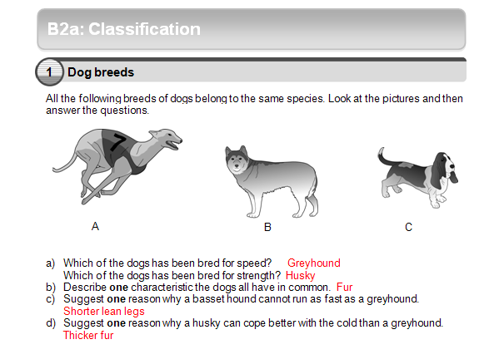

Slide 30
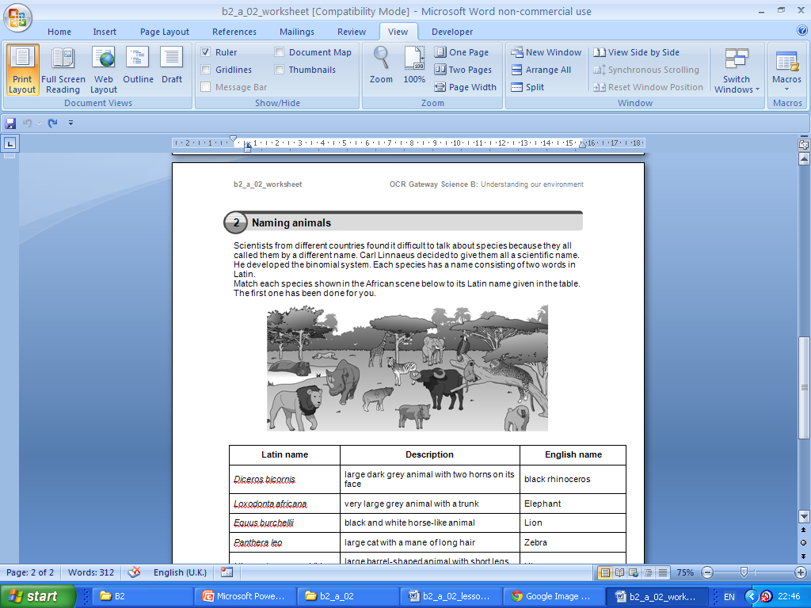

Slide 31
